Slide 1
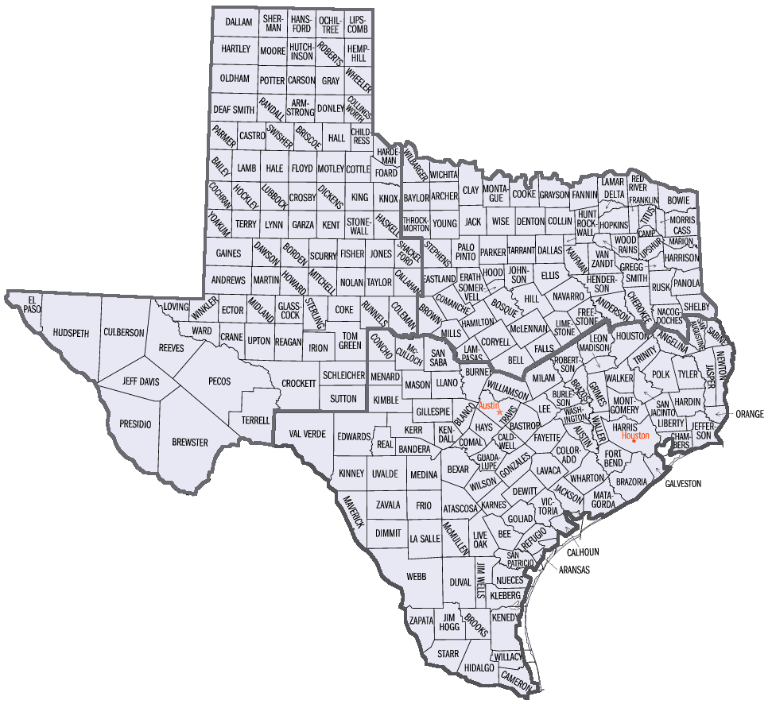




























































































14 Harris
01 Austin, Brazoria, Chambers, Fort Bend, Galveston, Liberty, Montgomery and Waller,
09 Jasper, Jefferson, Hardin, Newton, Orange, Sabine, San Augustine, and Tyler
02 Angelina, Houston, Polk, San Jacinto, Trinity, and Walker
05 Brazos, Burleson, Grimes, Leon, Madison, Robertson, and Washington
07 Bastrop, Caldwell, Fayette, Hays, Lee, Milam, Travis, and Williamson
10 Calhoun, Colorado, DeWitt, Goliad, Karnes, Jackson, Lavaca, Matagorda, Victoria, and Wharton
12 Atascosa, Bexar, Comal, Gonzales, Guadalupe, Kendall, and Wilson
08 Blanco, Burnet, Concho, Gillespie, Kimble, Llano, Mason, McCulloch, Menard and San Saba
04 Aransas, Bee, Live Oak, Kleberg, Jim Wells, Nueces, San Patricio, and Refugio
06 Bandera, Edwards, Kerr, Kinney, Medina, Real, Uvalde, and Val Verde
13 Dimmit, Duval, Frio, LaSalle, McMullen, Maverick, Webb, and Zavalla
15 Cameron, Kenedy, and Willacy
03 Brooks, Hidalgo, Jim Hogg, Starr, and Zapata
NTX
WTX
TEXAS ARES
HF NET
Districts in order of distance from Houston
08
05
02
07
09
06
14
12
10
01
13
04
03
15

